Slide 1
Glassdoor Reviews Analysis for BlueConch Technologies
By – Shounak Deshpande
(an independent project Using Python, data science, AIML, nLP, Selenium)
Web: https://shounak8.github.io/WebPage/index.html
LinkedIn: https://www.linkedin.com/in/shounak-deshpande-ab80b0105/
Email: Shounak.Deshpande@blueconchtech.com; Shounak.python@gmail.com

Slide 2
Introduction
This file covers the analysis based on the reviews posted by users on Glassdoor for Xpanxion (BCT) from 2012 till 23 May 2021.
Aim of this project is to draw conclusions which are backed by statistical data obtained from Glassdoor.
Text Analysis is done on:
Sentiment Analysis on Reviews
Identifying most popular keywords for Pros and Cons

Slide 3
Contents
General Statistics
Star Rating Analysis
Sentiment Analysis on Reviews
Pros and Cons
Conclusion

Slide 4
1. General statistics
Star Rating:
Average (Mean): 3.73 Stars
Median: 4 Stars
Mode: 4 Stars
Review Sentiment Analysis
Positive: 151
Neutral: 63
Negative: 16
Contributors:
Current Associates: 157
Former Associates: 73
Experience with BCT:
0 years: 84 Contributors
1 year: 84 Contributors
3 year: 42 Contributors
5 year: 15 Contributors
8 year: 2 Contributors
10 year: 3 Contributors

Slide 5
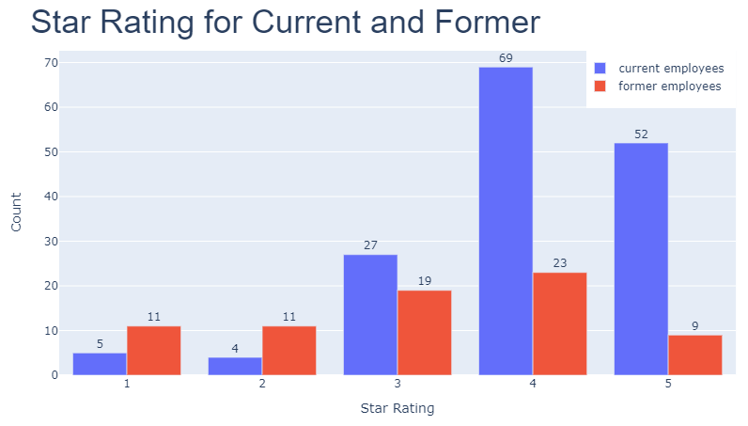
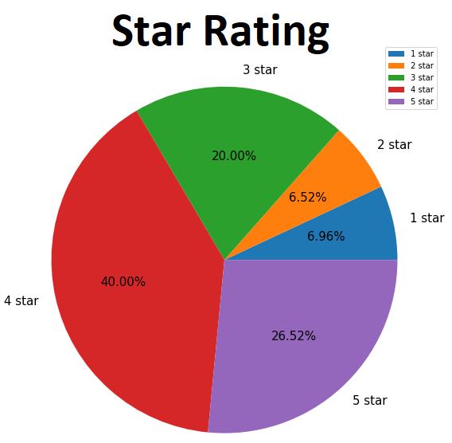
2. Star rating analysis
Conclusions:
Overall good rating for current employees shows we are doing well for current employees
Considering number of former employees is more than current employees when it comes to 1 & 2 star rating, it hints as souring of relations when the employee is leaving (potential field of improvement).

Slide 6
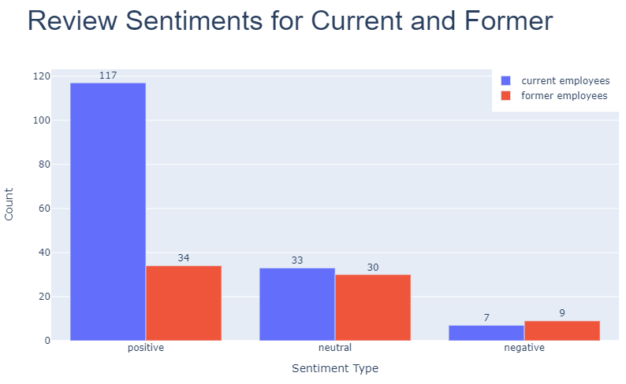
3. Sentiment Analysis on Reviews – Part a
Sentiment Analysis of Reviews shows that overall opinion of associates linked with Xpanxion is Positive.
Break-up of reviews:
65.6% Positive
27.4% Neutral
07.0% Negative
Former Associates harbours mixed to positive feeling towards the Organization.

Slide 7
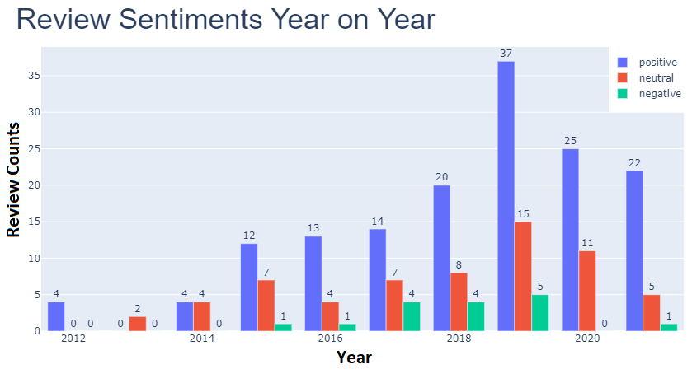
3. Sentiment Analysis on Reviews – Part B
Analysing Sentiments on year to year basis shows that Positive Reviews rose consistently till & peaked in 2019; BUT have declined consistently since then.
However, negative reviews have plummeted in the same time period.

Slide 8
4. Pros and cons (intro)
Pros and Cons for every review are analysed.
Depending upon the frequency of occurrence of a particular point, the points are arranged in descending order of their occurrence for Pros and Cons.
The list starts with the most frequently commented point and the frequency decreases as you go down the list.
From time and space consideration, I have mentioned the top 10 points.

Slide 9
4. Pros and cons (pointers)
PROS
Work Life Balance
Work Culture
Learning Opportunities
Work From Home
Variety of Projects
Technology
Flexible Work Hours
Big Name Clients
Support from Team
Relaxed Dress Code
CONS
No Work Life Balance
Rare On-Site Opportunities
Need training on People Management
No Job Security
No empathy from Management
Lack of Communication
Infrastructure needs improvement
Unreasonable Clients
Bonus not given
Not much growth

Slide 10
5. Conclusion
Considering the Star Rating, overall perception of the company is POSITIVE in the job market.
Deliberation can be done in the way Exiting Associates are treated prior to their exit (based on Star Rating given by exited associates).
Considering the decline of year-on-year positive review in 2020, the overall feel good factor of the Organization can be looked into.
Pros and Cons analysis can be used for the above mentioned points to overall improve the Employee Experience.

Slide 11
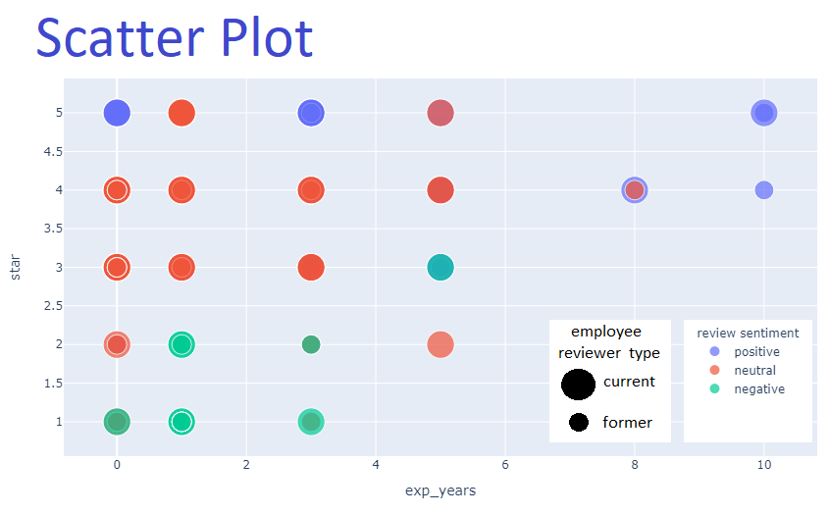
Miscellaneous: Overall Scatter Plot using the Data Frame

Slide 12


